Slide 1


Online Movie Ticket Booking Platform - Case Study
This presentation explores the overview, solution architecture and implementation plan for an online movie ticket booking platform.
by Mahesh Srinivas

Slide 2
Agenda
1
Introduction and Objectives
2
Key Requirements
3
Solution Architecture (AWS)
4
Infrastructure Sizing
5
Microservices and Data Management
6
NFR Requirements
7
Enterprise Systems
8
Estimation And Project Plan

Slide 3
Introduction and Objectives
Introduction
Objectives
A scalable, cloud-based platform for seamless movie ticket booking across multiple cities and languages.
User-friendly interface
High availability (99.99%) and scalability
Multi-language and regional support
Real-time seat selection and secure payment integration
Actionable analytics for theatre partners

Slide 4
Key Requirements
Non-Functional Requirements
Functional Requirements
User registration, login, and profile management
Scalability: Handle traffic spikes during blockbuster releases
Real-time seat selection and booking
Availability: Ensure 99.99% uptime
Payment gateway integration
Security: Comply with PCI DSS for payment processing & OWSP Threat mitigation
Notification system for booking confirmations
Performance: Low latency for users across multiple regions & cities.
Localization for multiple languages and regions

Slide 5




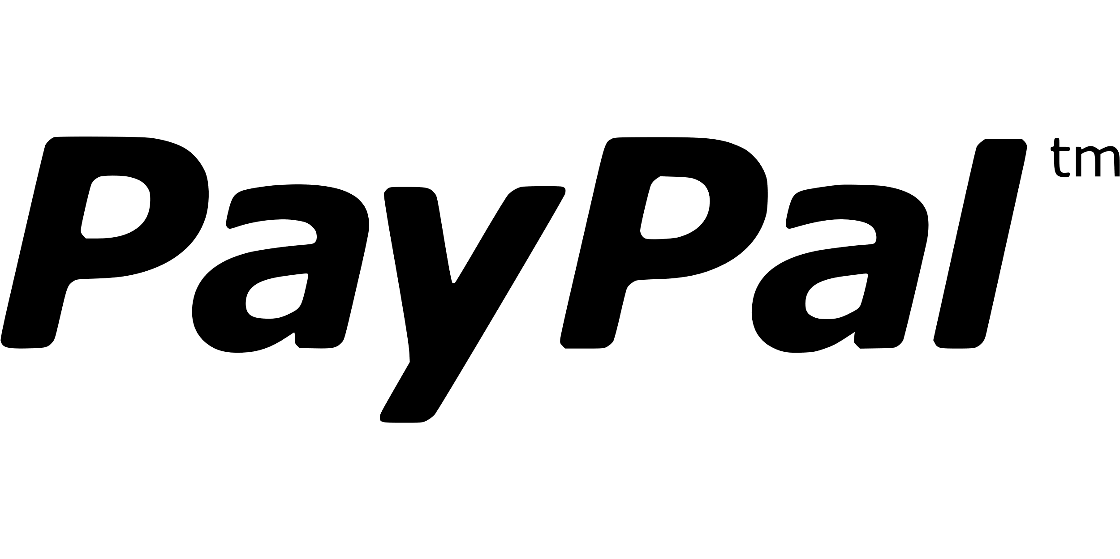
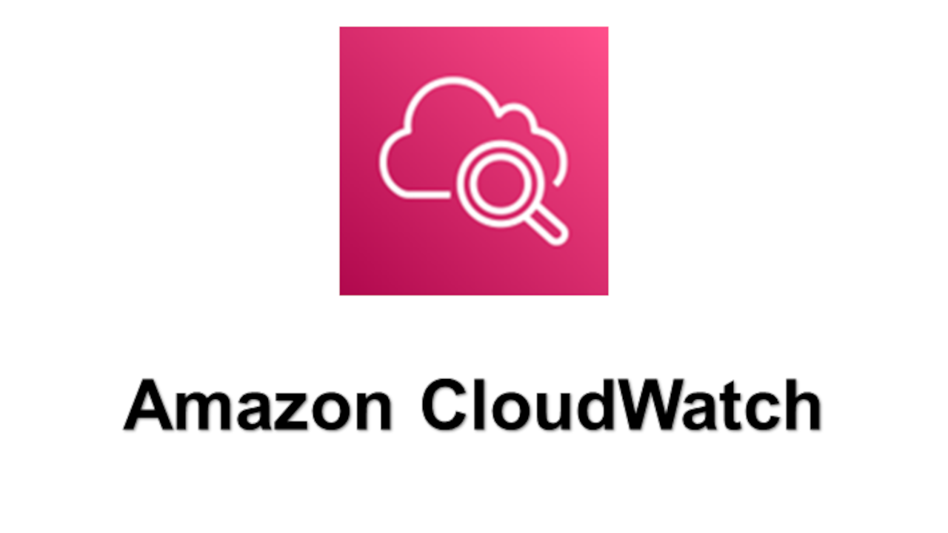
Solution Architecture (AWS)
Frontend
Backend
Authentication
Hosted on Amazon CloudFront with static assets in Amazon S3.
Microservices deployed on Amazon ECS (Fargate) with API Gateway.
Amazon Cognito.
Databases
Payment Integration
Monitoring
Amazon RDS (PostgreSQL) for transactional data, DynamoDB for movie metadata and user preferences.
Integration with payment gateway such as Paypal, Stripe, RazorPay etc for payment processing.
Amazon CloudWatch, AWS WAF, and Shield for security.

Slide 6
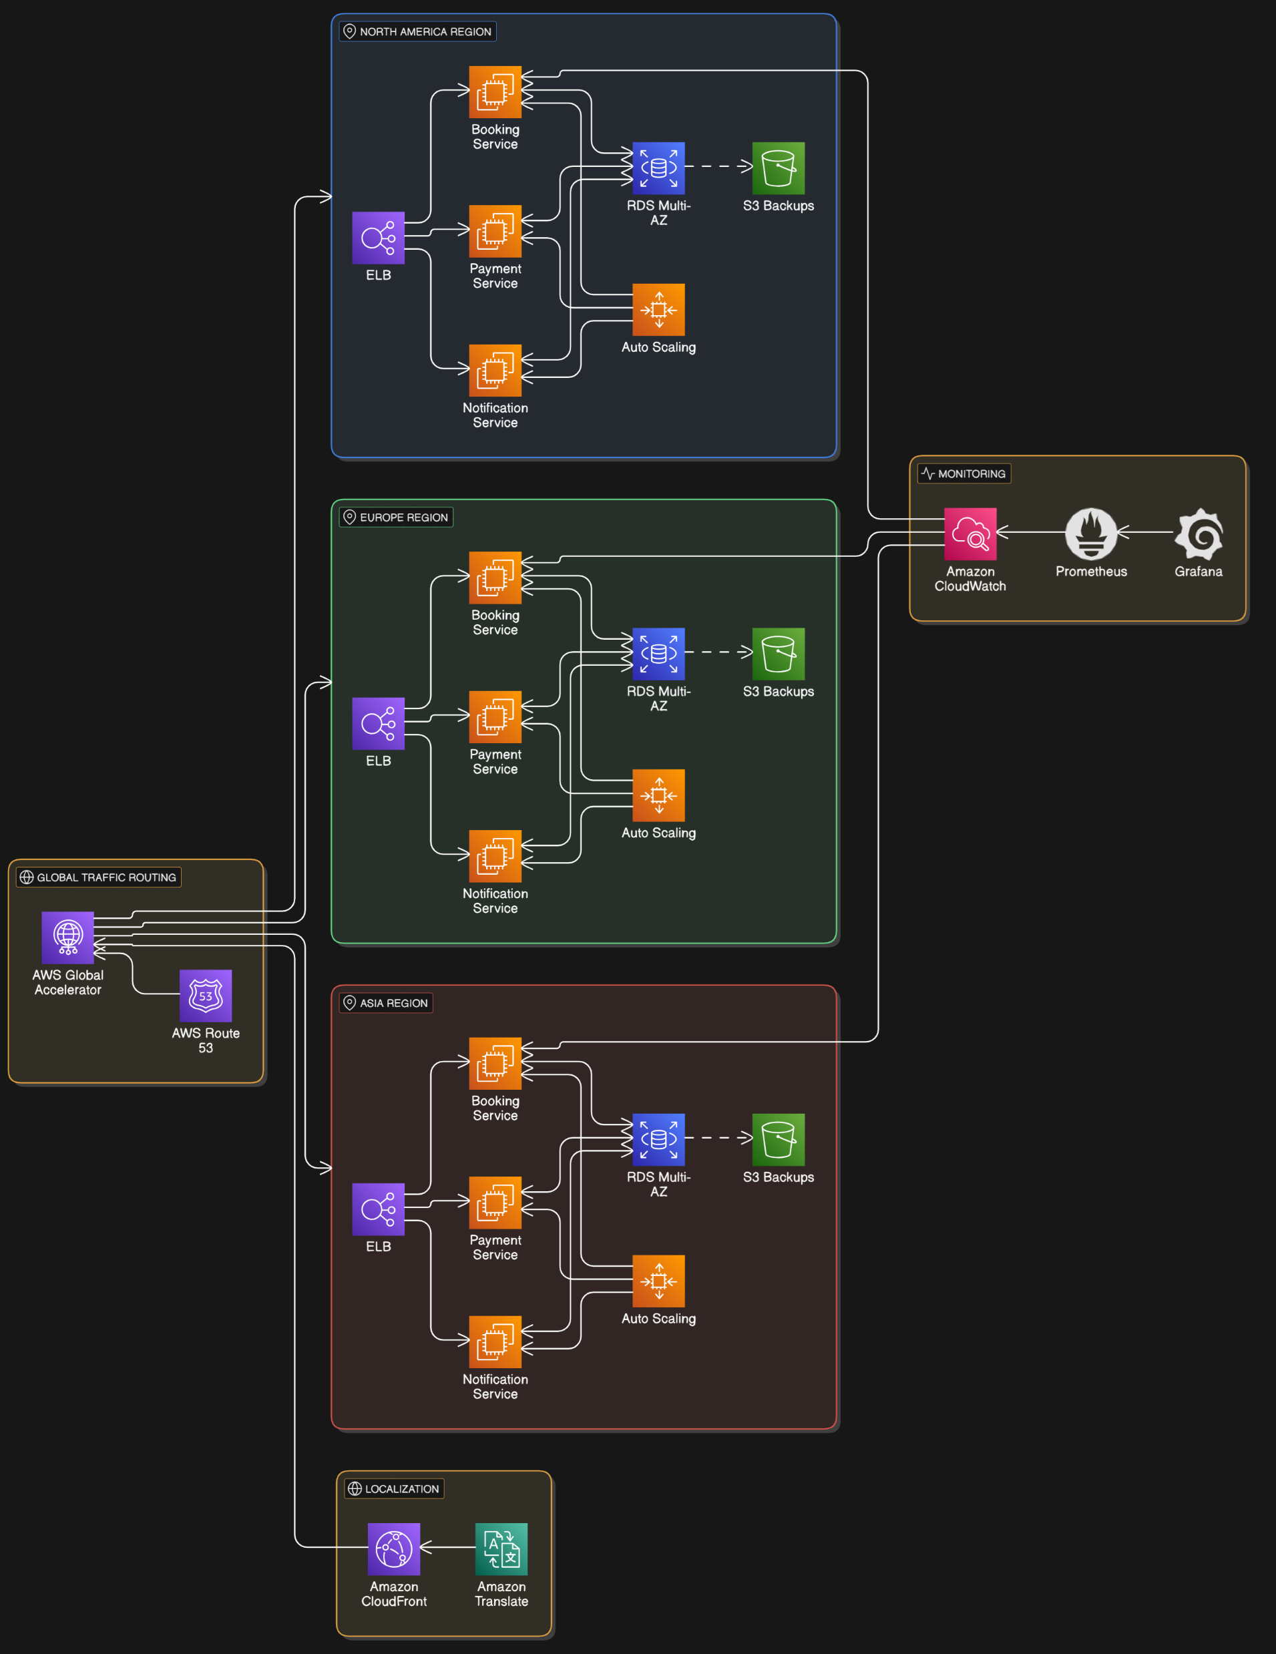
Solution Architecture (AWS)

Slide 7
Solution Architecture (AWS)
Comprehensive Approach
Security
Scalability
Cost Optimization
Monitoring & Logging
Utilize AWS services like IAM, VPC, and security groups to enforce robust security measures.
Leverage auto-scaling and load balancing to ensure applications can handle peak demands.
Implement cost-effective solutions by utilizing reserved instances, spot instances, and serverless computing.
Monitor application performance and identify potential issues with services like CloudWatch.

Slide 8
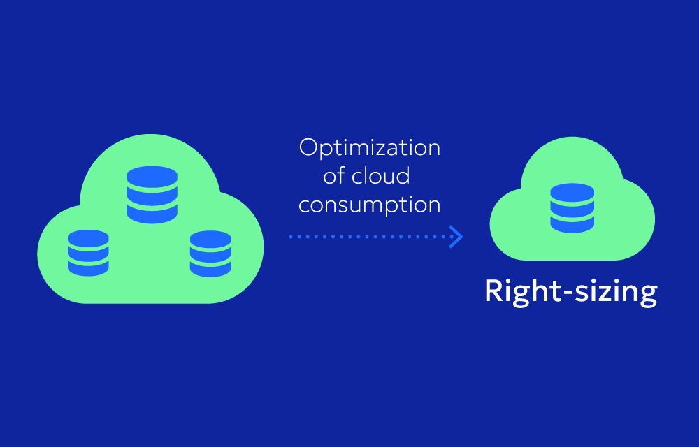

AWS Infrastructure Sizing
This section outlines the key infrastructure components required to scale a movie streaming platform and its sizing. We'll cover compute, database, storage, networking, monitoring, and logging.

Slide 9

Compute Resources: Microservices and Instances
Microservices Deployment
Instance Types
Deploy containerized microservices using Kubernetes for scalability and fault tolerance. Start with a small cluster (e.g., 3 nodes) and scale based on traffic.
Use general-purpose instances (e.g., AWS EC2 t3.medium) for most services. Employ compute-optimized instances (e.g., c5.large) for CPU-intensive tasks like analytics or search.

Slide 10


Database: Relational and NoSQL
Relational Database (PostgreSQL)
NoSQL Database (MongoDB)
Use a managed database service (e.g., AWS RDS) for transactional data like bookings and payments. Start with a db.t3.medium (2 vCPUs, 4GB RAM) with auto-scaling enabled.
Use a managed NoSQL service (e.g., DocumentDB, DynamoDB) for storing movie metadata and localization data. Begin with 10GB storage with auto-scaling.

Slide 11

Storage: Static Assets and Backups
Static Assets
Backup and Archival
Store movie posters, banners, and other static files in object storage (e.g., AWS S3). Enable a CDN (Content Delivery Network) like AWS CloudFront to cache assets globally and reduce latency.
Use S3 Glacier or equivalent for long-term storage of logs and backups.

Slide 12
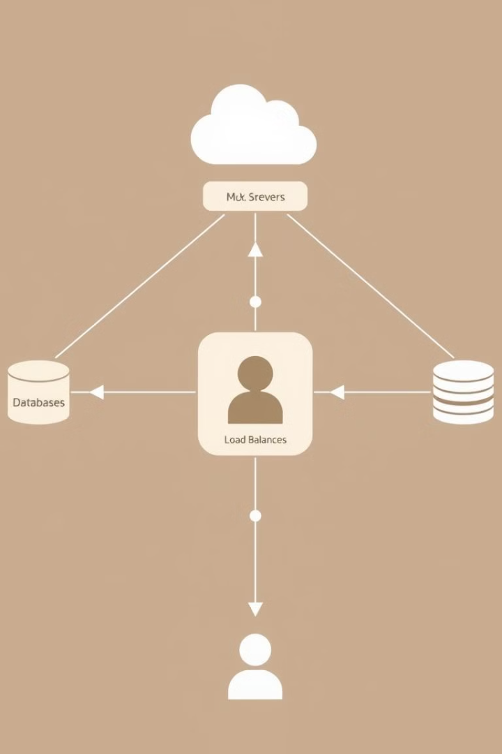
Networking, Monitoring, and Logging
1
Load Balancing
2
Traffic Management
Use a managed load balancer (e.g., AWS Elastic Load Balancer) to distribute traffic across microservices.
Use a global DNS service (e.g., AWS Route 53) to route users to the nearest data center.
3
VPC (Virtual Private Cloud)
4
Monitoring and Logging
Use AWS CloudWatch or equivalent for monitoring infrastructure and application performance. Utilize ELK Stack (Elasticsearch, Logstash, Kibana) for centralized logging and troubleshooting.
Deploy services in a secure VPC with subnets for public-facing and private services.

Slide 13

Cost Optimization Strategies
Auto-Scaling
Reserved Instances
Storage Tiering
Configure auto-scaling for compute and database resources to handle traffic spikes while minimizing costs during off-peak hours.
Purchase reserved instances for predictable workloads to save on long-term costs.
Use lifecycle policies to move infrequently accessed data to cheaper storage tiers (e.g., S3 Glacier).

Slide 14
Microservices Overview
User Management Service
1
Handles user registration, login, and profiles.
2
Theatre Management Service
Manages theatres, shows, and seat availability.
Movie Metadata Service
3
Stores and retrieves movie details, localized content.
4
Booking Service
Manages seat selection, booking confirmation.
Payment Service
5
Secure payment processing with third-party gateways.
6
Notification Service
Sends booking confirmations and reminders.
Analytics Service
7
Tracks user behavior, revenue, and operational metrics.

Slide 15




Data Management
Database Types
Relational (PostgreSQL) for transactional data and DynamoDB for storing User preferences, Movie metadata, localization content etc.
Data Flow Between Services
APIs for synchronous communication, event-driven architecture (SNS/SQS) for asynchronous communication.
Consistency
Eventual consistency using event-driven architecture, distributed transactions managed with Saga patterns.
Security
Encryption for sensitive data, access control for APIs and databases.

Slide 16
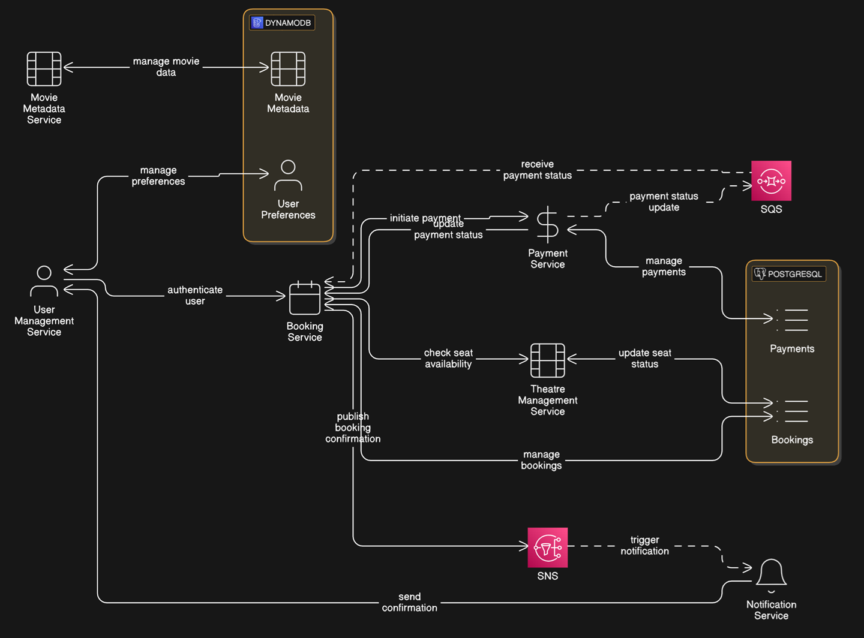
Data Management(contd)

Slide 17
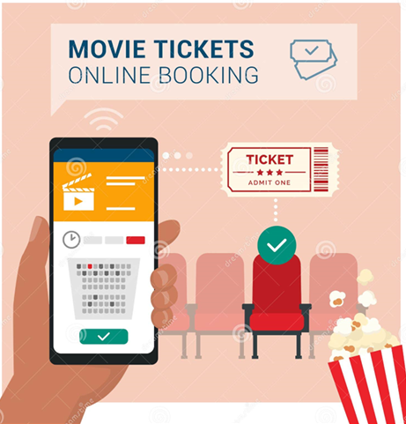
Database, Transactions, and Data Modeling for the Online Movie Ticket Booking Platform
For the online movie ticket booking platform, the database design, transaction management, and data modeling are critical to ensuring the platform's scalability, reliability, and ability to handle complex operations like bookings, payments, and localization. Below is a detailed discussion of these aspects tailored to the case study.

Slide 18

Database Design
Relational Database (PostgreSQL)
NoSQL Database (MongoDB)
Used for transactional data such as bookings, payments, and user accounts. Ensures ACID compliance for critical operations like ticket bookings and payment processing. Supports complex queries and relationships between entities (e.g., users, theatres, movies).
Used for semi-structured data like movie metadata, localization (e.g., translations), and user preferences. Provides flexibility for storing hierarchical or document-based data (e.g., movie descriptions in multiple languages).

Slide 19

Database Schema
Users Table
Theatres Table
Stores user information like name, email, and preferences.
Stores theatre details including name, location.
Movies Table
Shows Table
Stores movie details such as title, genre, and duration.
Links movies and theatres, representing specific showtimes.
Bookings Table
Payments Table
Tracks user bookings, including seat selection and payment status.
Stores payment details for bookings, including amount and method.

Slide 20
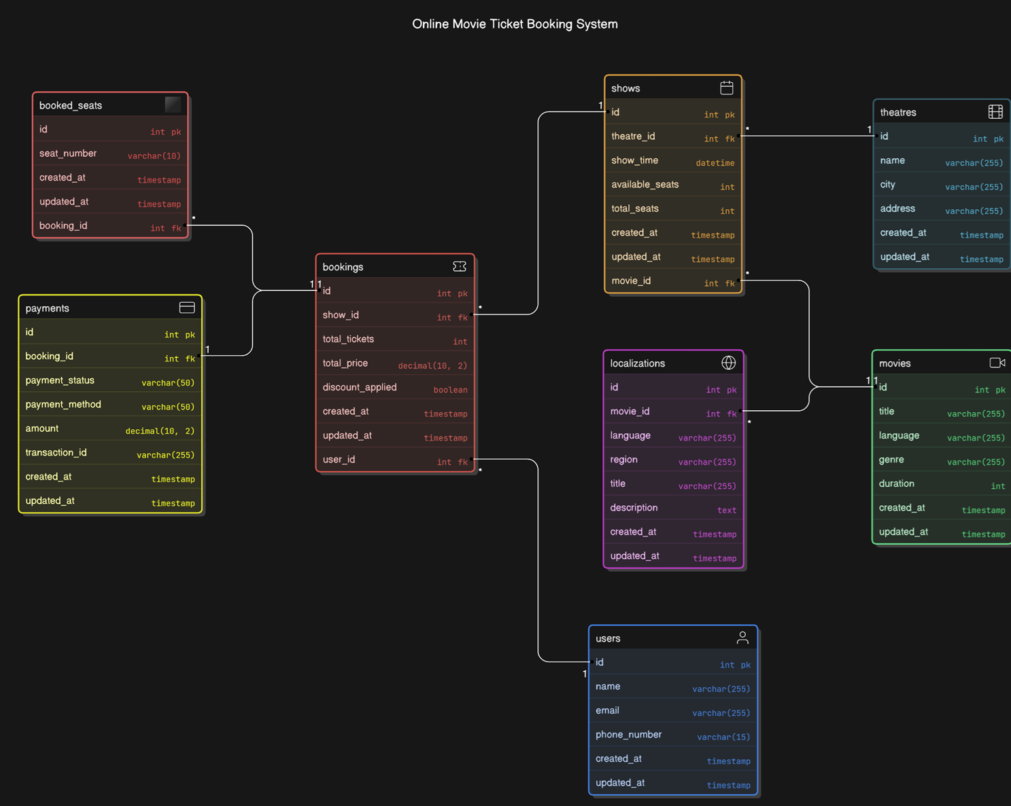

Slide 21

Core Collections in DynamoDB
Movies Metadata Collection
User Preferences Collection
Stores movie descriptions, posters, and trailers in multiple languages.
Stores user-specific preferences like favorite genres or preferred languages.

Slide 22

Transactions
ACID Properties: Ensures atomicity, consistency, isolation, and durability for critical operations.
Concurrency Control: Manages simultaneous access to data to prevent conflicts and data corruption.
Transaction Isolation Levels: Defines the level of isolation between concurrent transactions (e.g., read committed, serializable).
Rollback and Recovery: Mechanisms to undo failed transactions and recover from system failures.
Booking Process: Atomically updates ticket availability, user accounts, and payment status.
Payment Processing: Securely handles financial transactions, ensuring integrity and prevention of double payments.

Slide 23
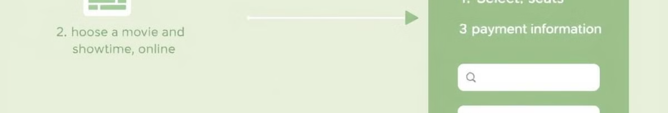

Transactions
1
Importance of Transactions
2
ACID Properties
Transactions are critical for ensuring data consistency and integrity, especially for operations like ticket bookings and payments.
Relational databases like PostgreSQL ensure ACID compliance: Atomicity, Consistency, Isolation, Durability.
3
Transaction Flow Example
4
Distributed Transactions
Booking a Ticket: Check seat availability, reserve the seat, insert a new record in the Bookings table, process the payment, and commit the transaction if all steps succeed.
If the platform uses multiple databases, distributed transactions may be required. Tools like Two-Phase Commit (2PC) or sagas can be used to ensure consistency across databases.

Slide 24
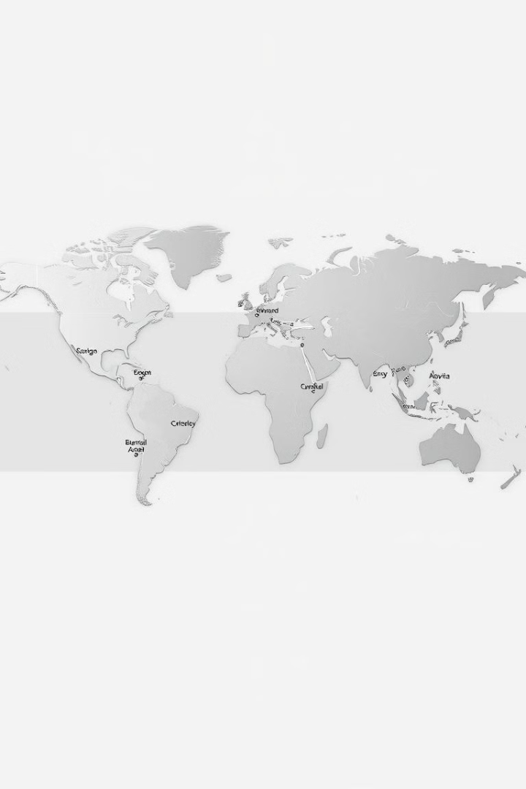
NFR Requirement: Release Management Strategies
Managing software releases for a regional audience presents unique challenges. This section explores our strategic approach to address these challenges, ensuring smooth, timely, and high-quality releases across diverse locations and languages.

Slide 25






Addressing Release Challenges
Phased Rollouts
We mitigate the complexity of diverse geographies by implementing phased rollouts. This approach allows us to gradually introduce new features and updates, starting with a limited region and expanding as we gather feedback and address potential issues.
Localization & Translation
We leverage specialized tools like AWS Translate to manage translations efficiently. These tools streamline the process, ensuring consistent quality and accuracy across different languages.
1
2
3
4
Blue-Green Deployment
Feature Flags
To ensure zero downtime during releases, we employ blue-green deployment. This strategy involves running the new version alongside the existing version in parallel, with minimal impact on users, allowing us to switch over seamlessly.
Feature flags provide granular control over feature rollouts, allowing us to introduce new functionalities incrementally and monitor user feedback before full-scale deployment.

Slide 26
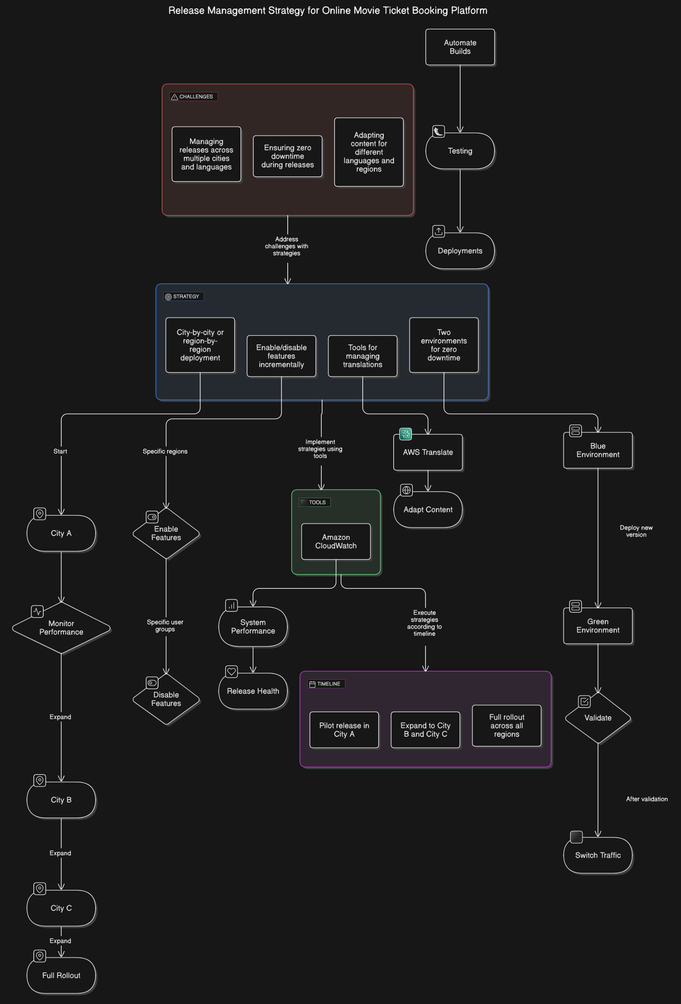
Release Management Strategies

Slide 27
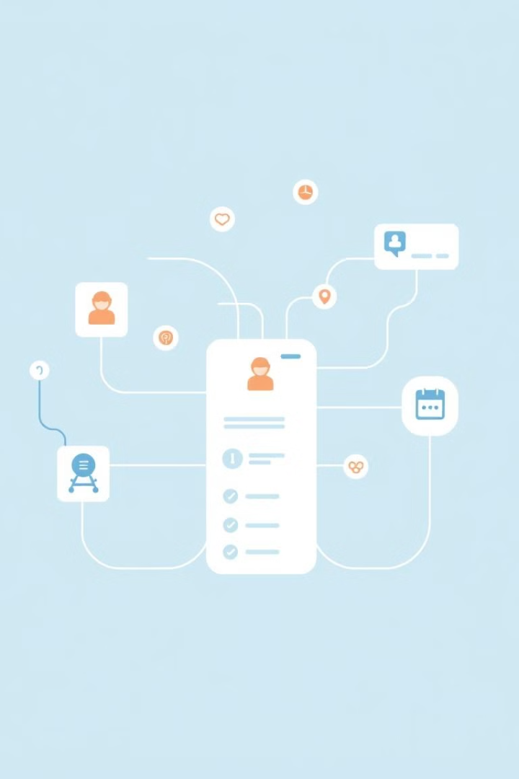
NFR Requirement: Booking System Design -Transactional Scenarios and Decisions
This section will explore crucial transactional scenarios and design decisions for a reliable and scalable booking system.

Slide 28
Transactional Scenarios
Seat Booking
Payments
Ticket Cancellation
Notifications
Prevent double bookings using distributed locks or database transactions for real-time seat availability.
Ensure atomicity for payments with the Saga pattern, managing transactions across booking and payment services.
Allow partial rollbacks, refunding payments and releasing seats if a cancellation occurs.
Employ asynchronous communication for booking confirmations using services like SNS/SQS.

Slide 29
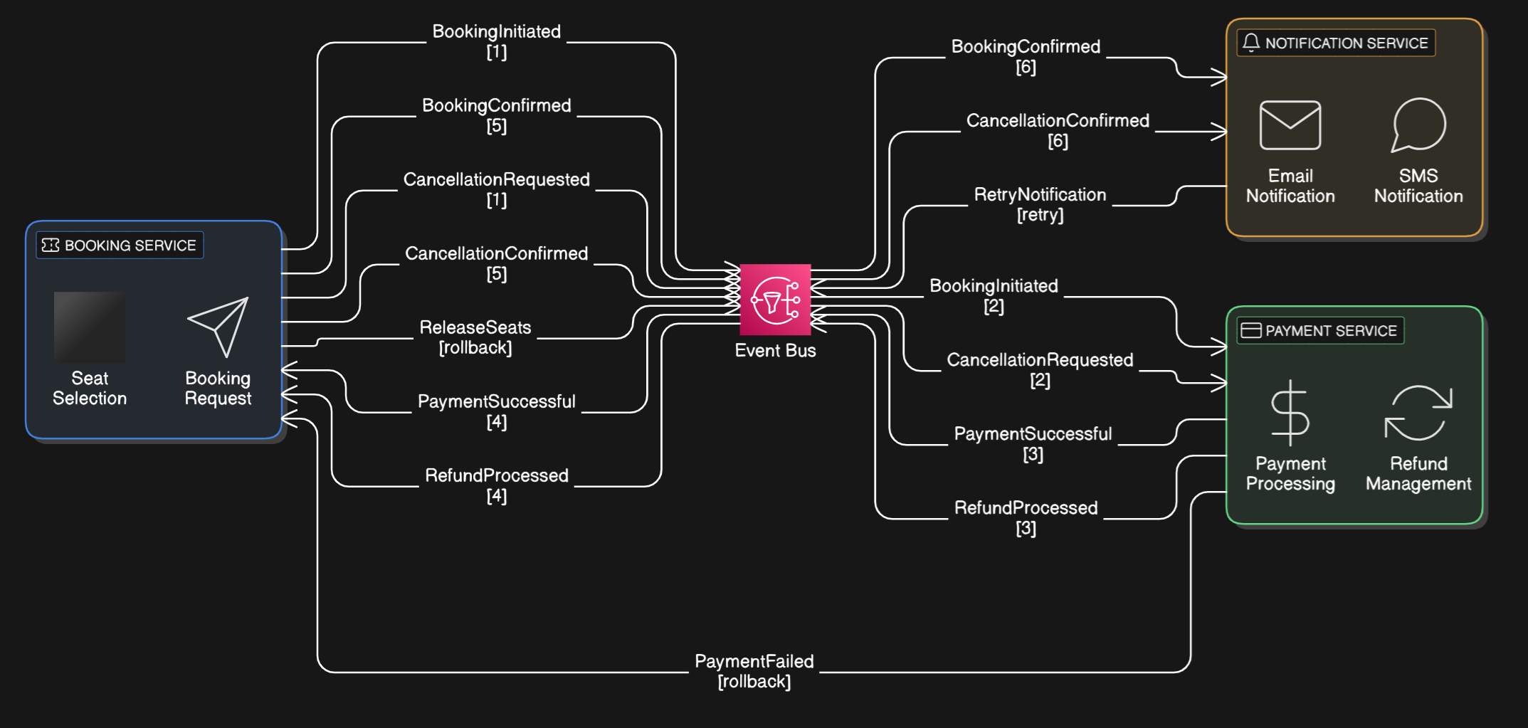
Transactional Scenarios

Slide 30
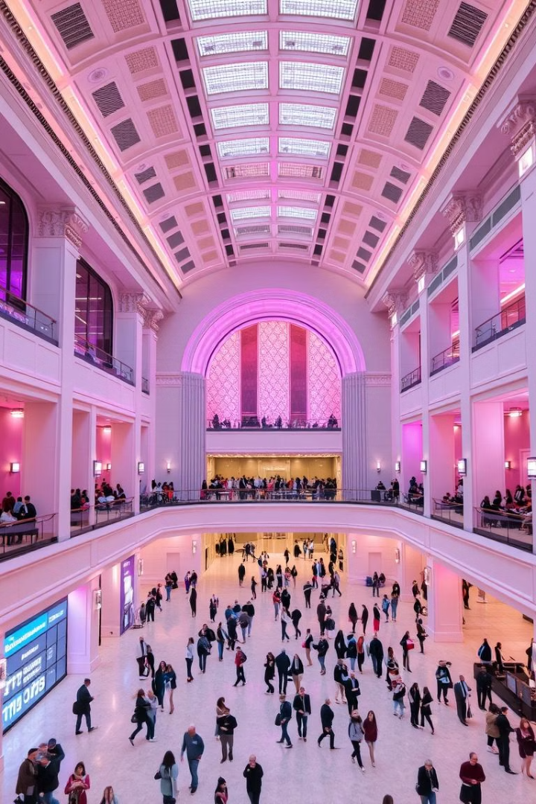
NFR Requirement: Integrating Theatre Ticketing Platform
This section outlines the approach for integrating the ticketing platform with various theatre systems and localizing the content for diverse audiences.

Slide 31
Theatre System Integration
Existing Systems
New Theatres
Integrate with existing theatre IT systems using APIs or adapters. This ensures compatibility and leverages existing data. Example: Map platform schema to theatre databases.
Provide a lightweight, SaaS-based theatre management module for theatres without IT systems. This enables them to easily upload show schedules and manage their operations.

Slide 32
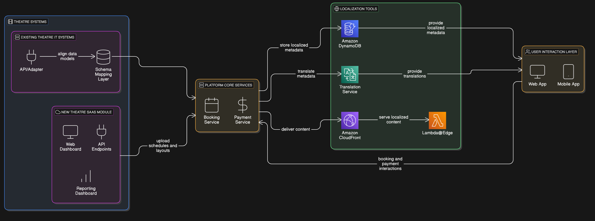
Theatre System Integration

Slide 33

NFR Requirement: Scaling a Global Entertainment Platform
Providing a consistent entertainment experience to a global audience demands meticulous planning and execution. This section details key strategies for platform scaling across numerous cities, states while ensuring high availability.

Slide 34
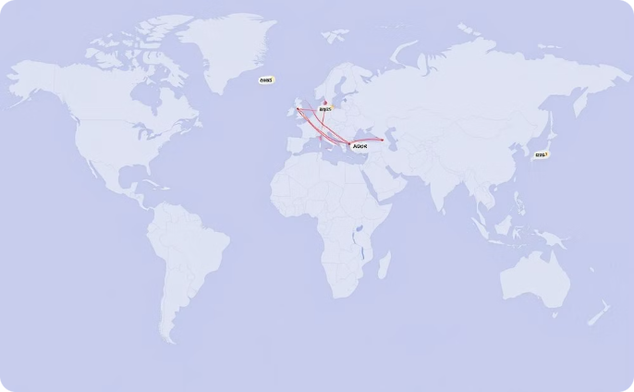

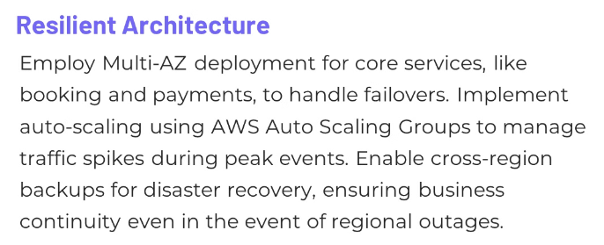
Global Reach and High Availability
Global Deployment
Deploy services across AWS Regions for low latency, data residency compliance, and multilingual support.

Slide 35
Global Reach&High Availability(Example)

Slide 36
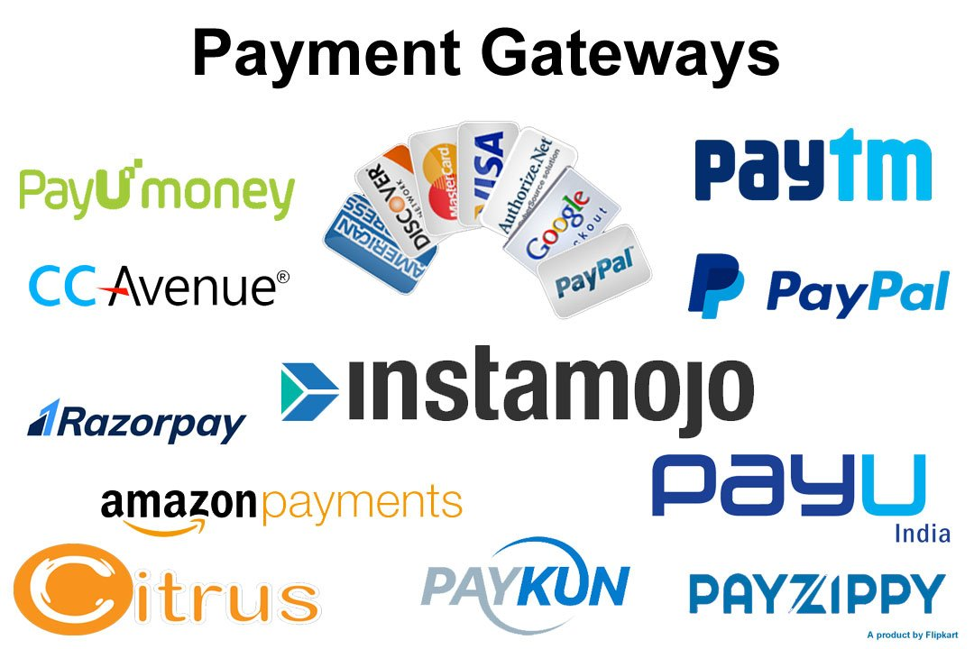
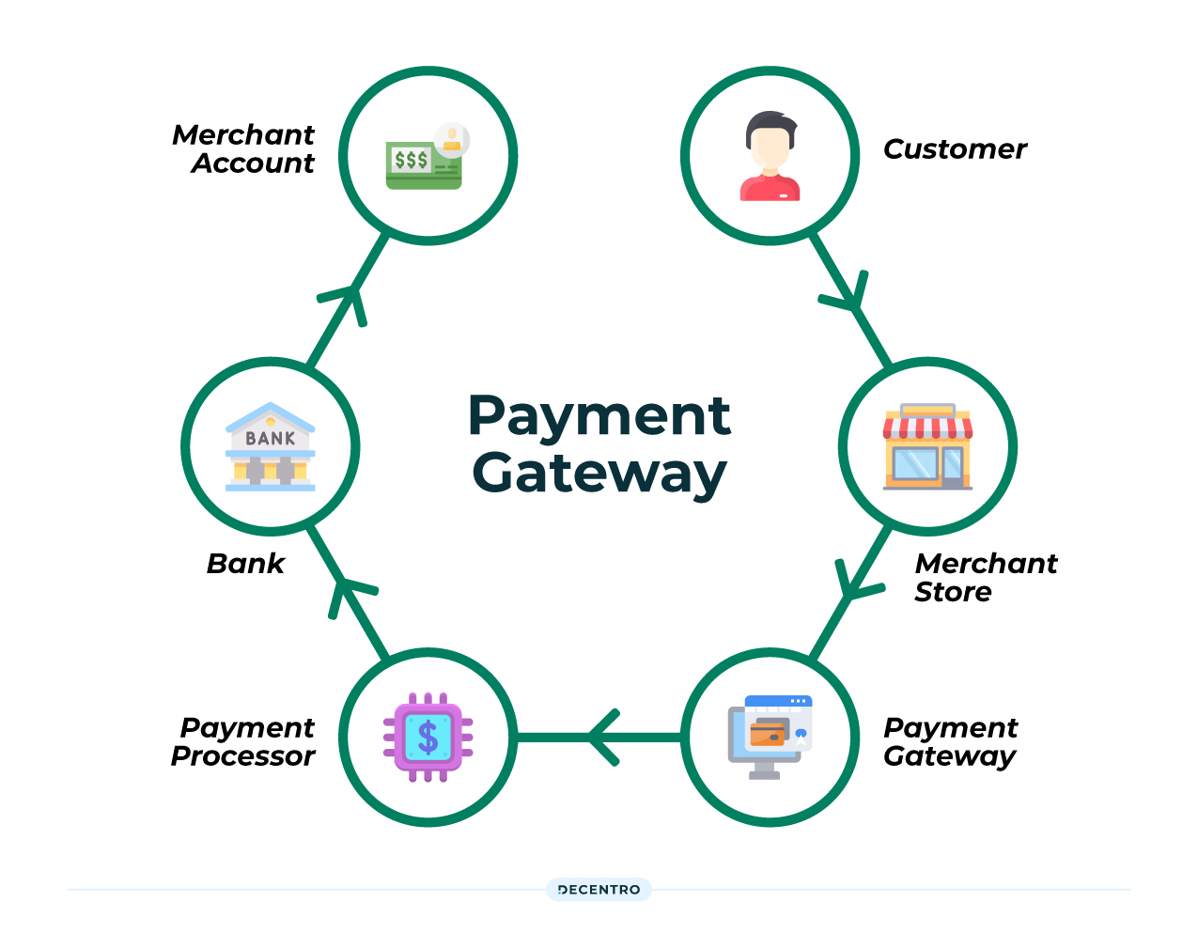
NFR Requirement: Payment Gateway Integration
This section outlines the design choices and workflow for integrating payment gateways into our system.

Slide 37
Design Decisions & Workflow
Key Design Choices
Security & Compliance
Support for multiple payment gateways (e.g., Stripe, Razorpay, PayPal) enhances flexibility and redundancy.
Tokenization protects sensitive payment data, ensuring PCI DSS compliance.
A payment orchestration service dynamically routes transactions, maximizing performance.
Offloading payment processing to third-party gateways minimizes compliance risks.

Slide 38
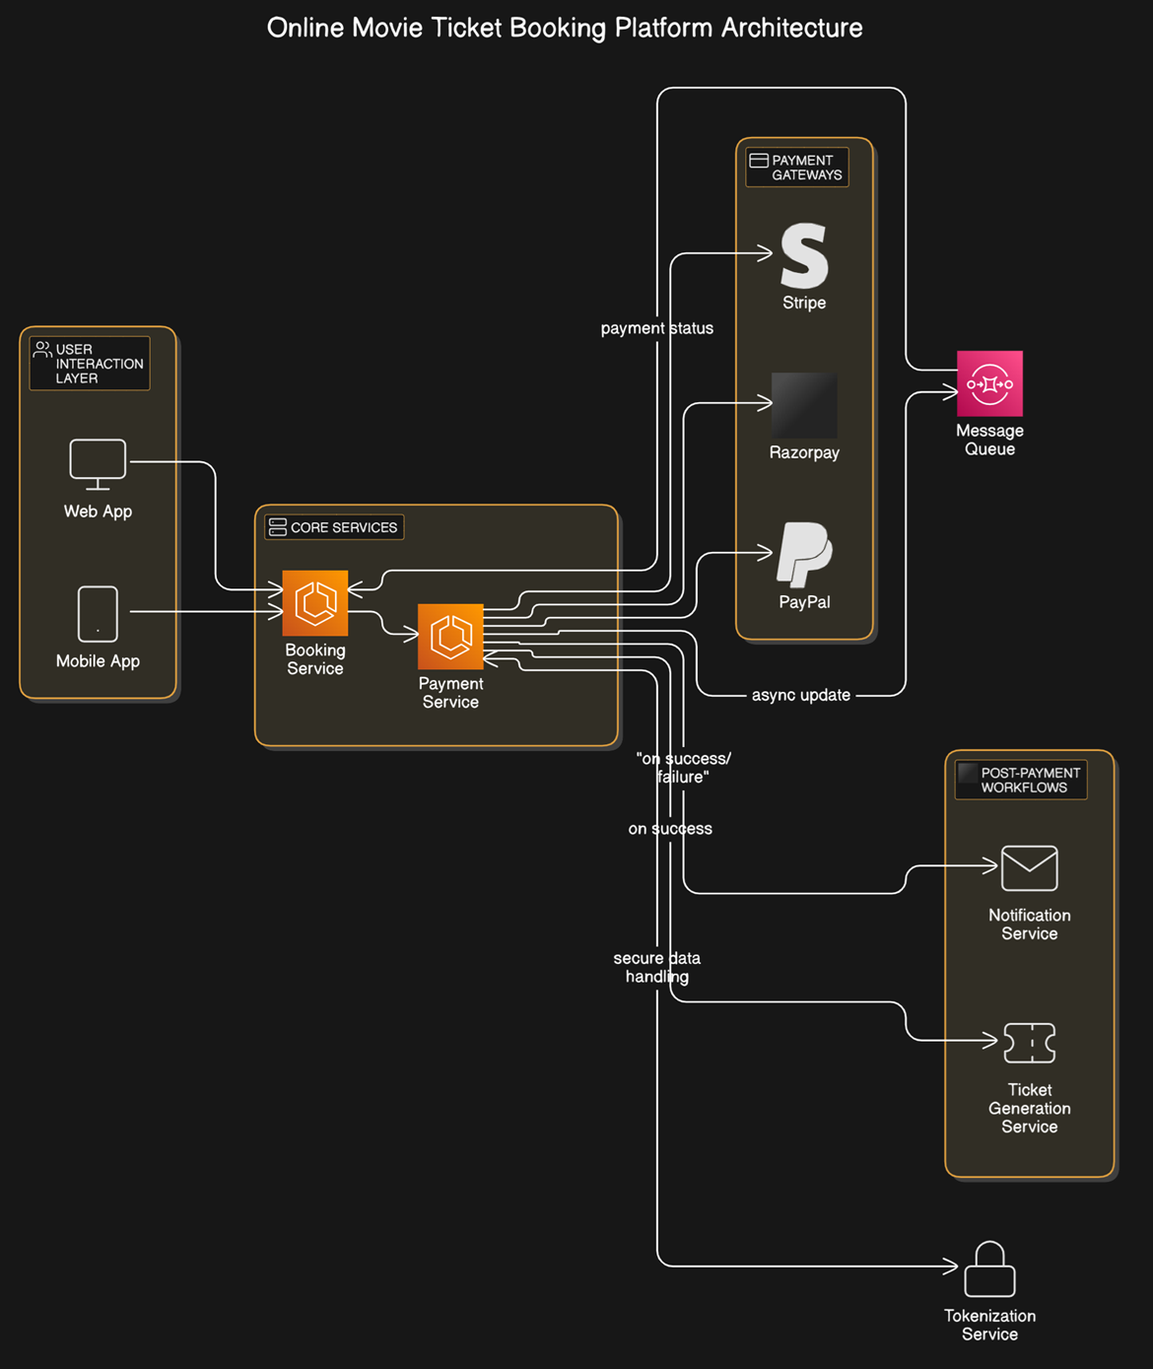
Payment Gateway Architecture

Slide 39
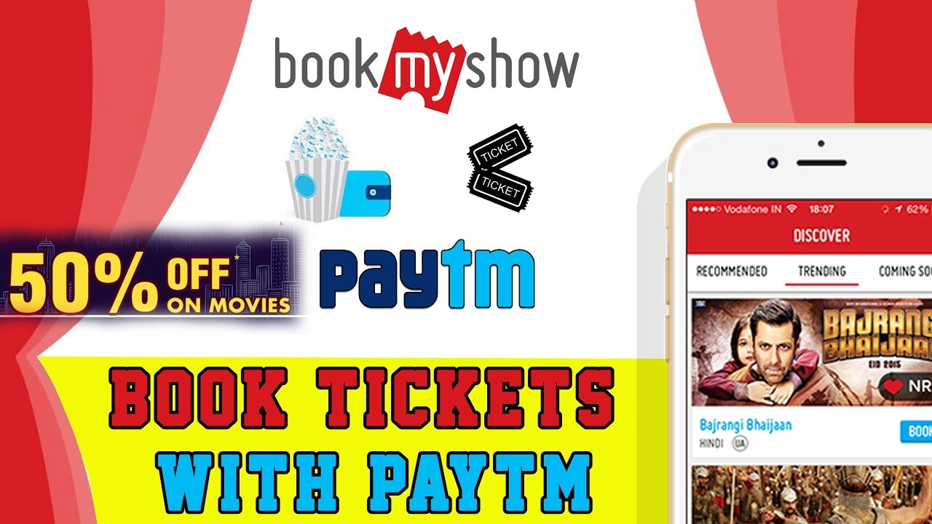
NFR Requirement: Monetization Strategies for Our Ticket Platform
This section explores the key monetization strategies for our online ticketing platform, focusing on revenue streams, business model, and strategic partnerships.

Slide 40
Revenue Streams: A Multifaceted Approach
Booking Fees
Subscription Plans for Theatres
Charge a small commission on every ticket booking, typically ranging from 2-5% of the ticket price. This provides a consistent revenue stream based on transaction volume.
Offer subscription plans to theatres providing access to a suite of SaaS tools, such as theatre management software, data analytics dashboards, and marketing automation features.

Slide 41


Additional Revenue Sources
Targeted Advertising
Payment Gateway Partnerships
Generate revenue through targeted advertisements for upcoming movies, events, or promotions displayed to users based on their interests and preferences.
Partner with payment gateway providers, earning a commission for high transaction volumes on the platform.

Slide 42



Business Model: Value for Users and Theatres
1
Free for Users
Premium Features
2
For Theatres
Monetization
3
Booking Fees, Subscriptions, Advertisements, Partnerships

Slide 43
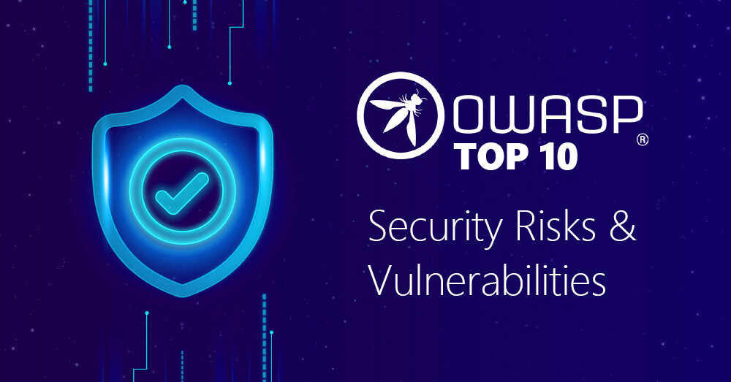
NFR Requirement: Mitigating Top 10 Web Security Threats in AWS

Slide 44
Injection Flaws: A Leading Threat
The Problem
AWS Solutions
Injection vulnerabilities allow attackers to execute malicious code within your application, often by manipulating user inputs. This can lead to data theft, unauthorized access, and system compromise.
Prevent injection attacks using parameterized queries, ORM frameworks, and input validation. Utilize AWS services like Amazon RDS for secure database management and AWS Lambda for serverless functions.

Slide 45



Broken Authentication: Compromised User Accounts
User Authentication
Authentication Services
Implement strong password policies, multi-factor authentication (MFA), and secure session management to prevent unauthorized access to sensitive data.
Leverage AWS Cognito for robust user authentication and authorization, enabling secure user management and identity federation.

Slide 46
Sensitive Data Exposure: Protecting Confidential Information
At Rest
In Transit
Encrypt sensitive data stored in databases, files, and logs using AWS Key Management Service (KMS). Regularly audit access controls and encryption policies.
Secure communication channels by using Transport Layer Security (TLS 1.2+) for all data transmission. Utilize AWS services like AWS Certificate Manager for easy SSL/TLS certificate management.

Slide 47

Security Misconfiguration: Unsecured Environments
Automated Configurations
Regular Audits
Conduct regular security audits to identify misconfigurations and vulnerabilities. Utilize AWS Security Hub for centralized security management and vulnerability detection.
Use AWS Config to automatically evaluate and enforce resource configurations, ensuring compliance with security best practices.

Slide 48



Cross-Site Scripting (XSS): Exploiting Trust
User Input Validation
Sanitize all user inputs to remove potentially malicious scripts. Use libraries and tools for effective input validation and encoding.
Content Security Policy (CSP)
Implement CSP headers to restrict the resources that can be loaded within your web application, reducing the risk of XSS attacks.

Slide 49


Broken Access Control: Bypassing Authorization
Role-Based Access Control (RBAC)
Implement RBAC to grant users access only to the resources they need. Use AWS Identity and Access Management (IAM) to define fine-grained permissions.
1
Permission Validation
2
Validate permissions on every request to ensure authorized access. Utilize AWS Lambda authorizers to enforce access control policies for API Gateway requests.

Slide 50
Using Vulnerable Components: Exploiting Dependencies
Regular Patching
1
Regularly patch dependencies and vulnerabilities in your software components. Use tools like Dependabot for automated vulnerability scanning and patching.
Dependency Management
Utilize dependency management tools to track and control dependencies, ensuring the use of secure and up-to-date components.
2

Slide 51

CSRF Attacks: Exploiting User Trust
1
CSRF Tokens
2
Secure Cookies
Implement CSRF tokens for form submissions to prevent unauthorized requests from attackers. Utilize AWS services like Amazon CloudFront for secure content delivery and CSRF protection.
Use HTTPS Only and Secure flags for cookies to prevent unauthorized access and cross-site scripting attacks.

Slide 52
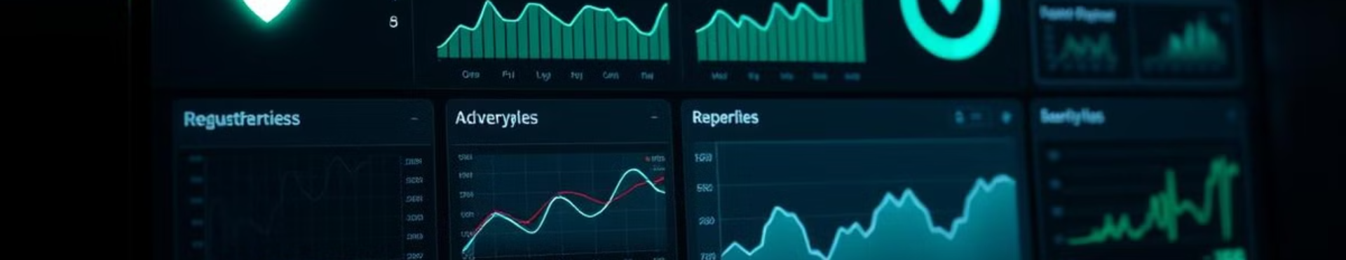
Insufficient Logging and Monitoring: Blind Spots
1
2
Detailed Logging
Security Monitoring
Enable detailed logging with AWS CloudTrail to capture all API calls and events in your AWS account. Use AWS CloudWatch for monitoring and analyzing logs.
Continuously monitor logs for suspicious activity and security threats. Utilize AWS services like Amazon GuardDuty for threat detection and response.

Slide 53
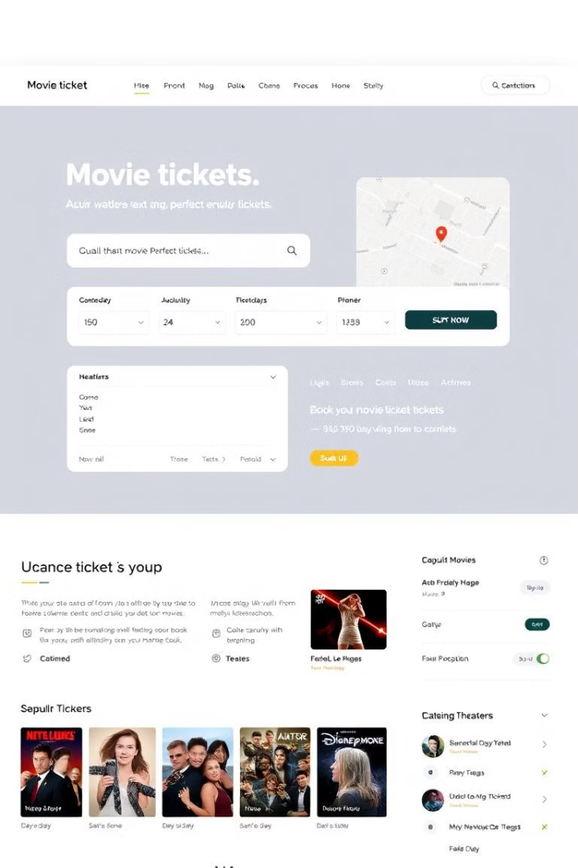
NFR Requirement: Key Performance Indicators (KPIs) for the Online Movie Ticket Booking Platform
Measuring Business Success, Operational Efficiency, and Technical Excellence

Slide 54
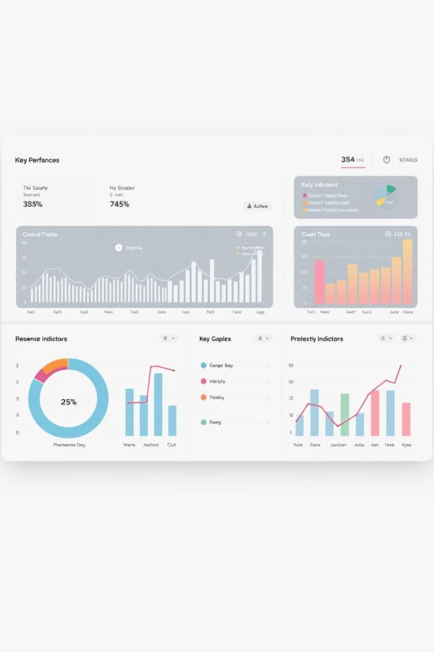
Why KPIs are Important?
Definition
Purpose
Measurable values that demonstrate how effectively the platform meets its goals.
Track business success, ensure operational efficiency, monitor technical performance.
Categories
Business, Operational, Technical, Localization.

Slide 55
Business KPIs
Revenue Metrics
Customer Metrics
Market Penetration
Total Revenue, ARPU, Commission Revenue.
Active Cities, Theatre Partner Growth Rate.
Customer Retention Rate, CAC, NPS.

Slide 56
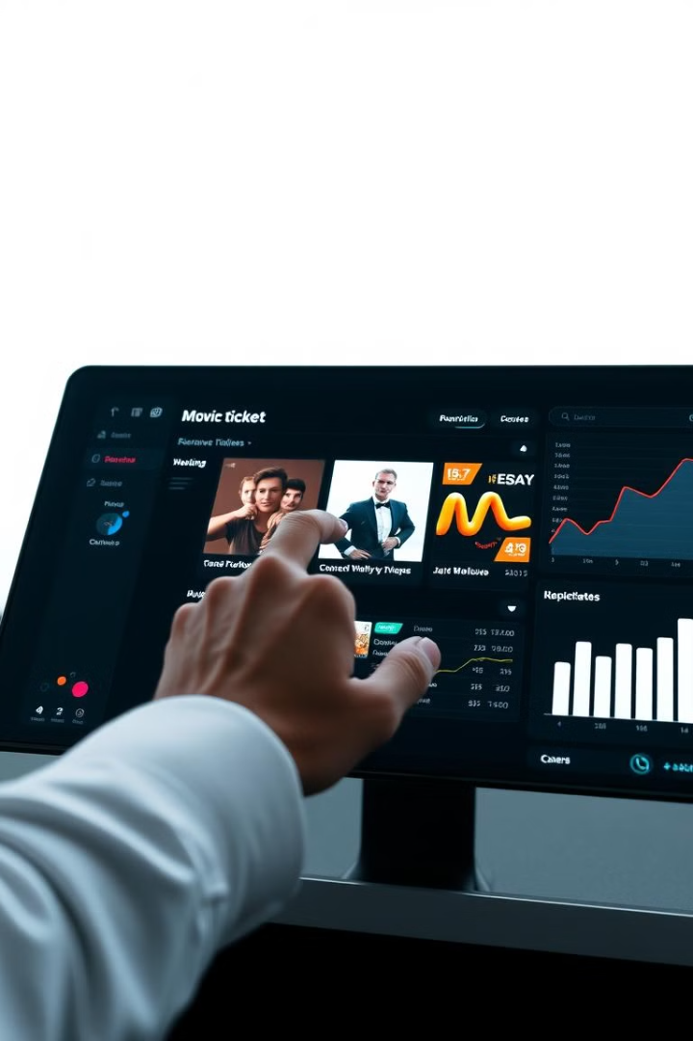
Operational KPIs
Booking Metrics
Payment Metrics
Conversion Rate, Abandonment Rate, Average Booking Time.
Payment Success Rate, Refund Processing Time.
Customer Support Metrics
Average Response Time, First Call Resolution (FCR).

Slide 57
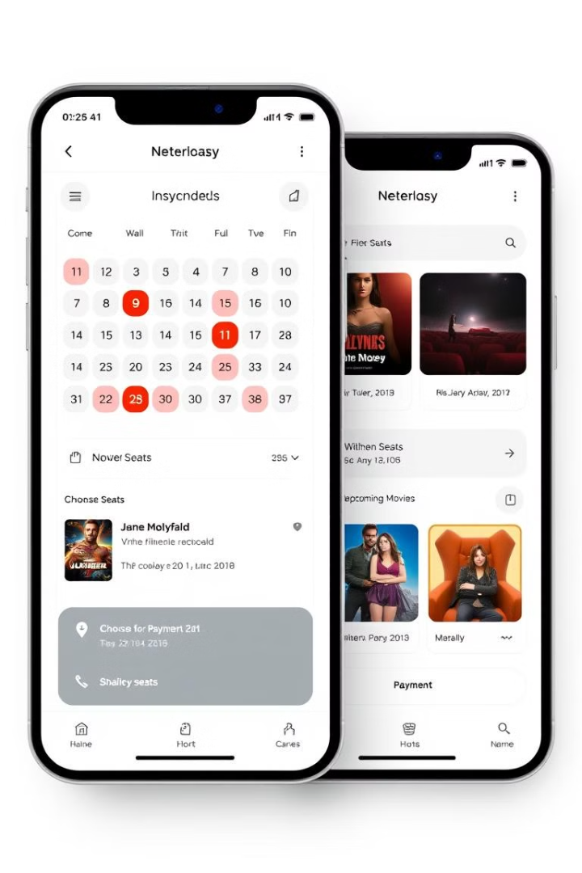



Technical KPIs
Performance Metrics
Scalability Metrics
API Response Time, System Latency.
Peak Traffic Handling, Autoscaling Efficiency.
Security Metrics
Number of Security Incidents, TTD, TTR.

Slide 58
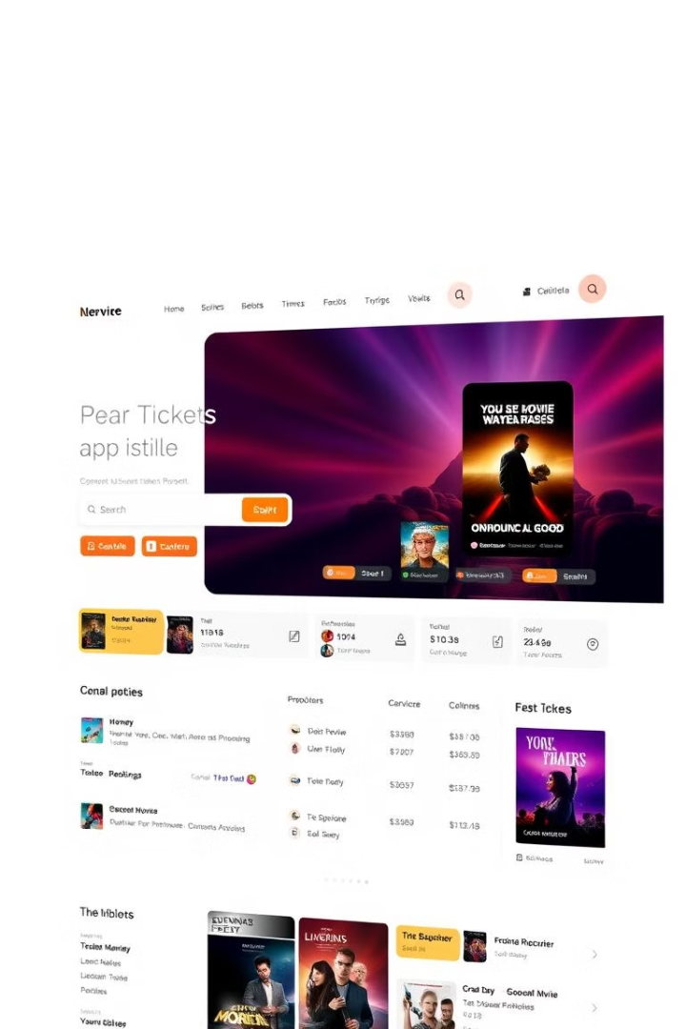
Localization KPIs
Localized Content
1
Percentage of movies and metadata available in multiple languages.
Regional User Engagement
2
Measure user activity in specific regions or languages.
Localization Accuracy
3
User feedback-based accuracy of translations and culturally relevant content.

Slide 59
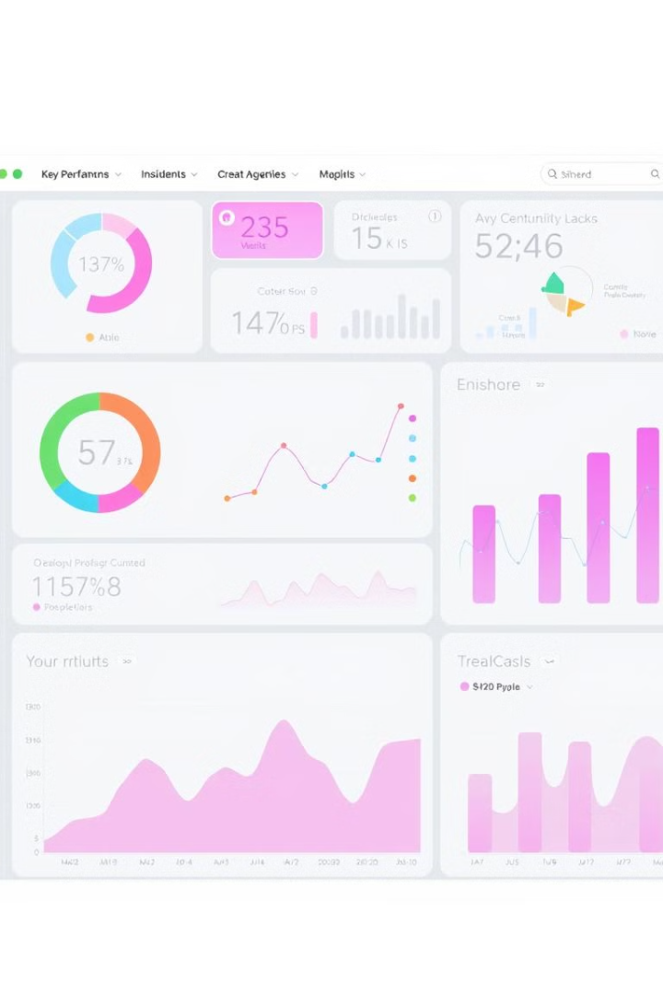
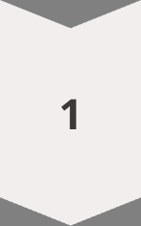


Monitoring and Reporting KPIs
Real-Time Dashboards
Tools: Grafana, Kibana, Google Analytics, or custom
dashboards.
Monthly Reports
Analyze business KPIs (e.g., revenue, customer
satisfaction).
Alerts and Notifications
Set up alerts for critical metrics (e.g., uptime, payment success rate).

Slide 60




Conclusion: Why KPIs Matter
1
Actionable Insights
2
Drive Revenue Growth
3
Ensure Scalability and Availability
4
Deliver Exceptional Customer Satisfaction

Slide 61


Building a Robust Platform: Essential Enterprise Systems for Success
This section outlines the key systems required for a successful movie ticketing platform, covering everything from financial management to customer engagement.

Slide 62


Enterprise Resource Planning (ERP) System
Financial Management
Inventory Management
Automate revenue tracking from ticket sales, convenience fees, and commissions.
Track seat availability and show schedules across multiple theatres.
Manage invoicing and payment reconciliation with theatre partners.

Slide 63
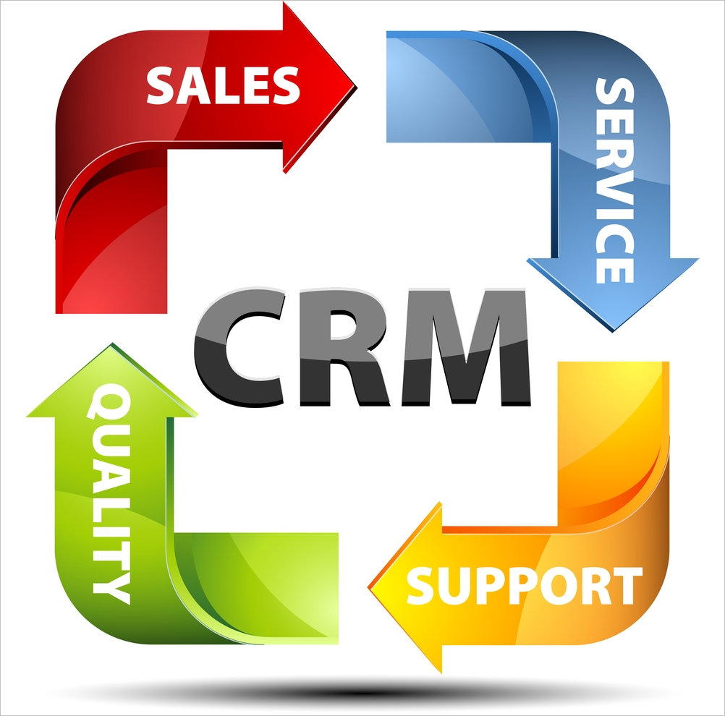

Customer Relationship Management (CRM) System
1
Customer Data Management
2
Personalized Marketing
Store and manage customer profiles, preferences, and booking history.
Use customer data to send targeted promotions, discounts, and recommendations.
3
Customer Support
Provide a centralized platform for handling customer queries, complaints, and feedback.

Slide 64
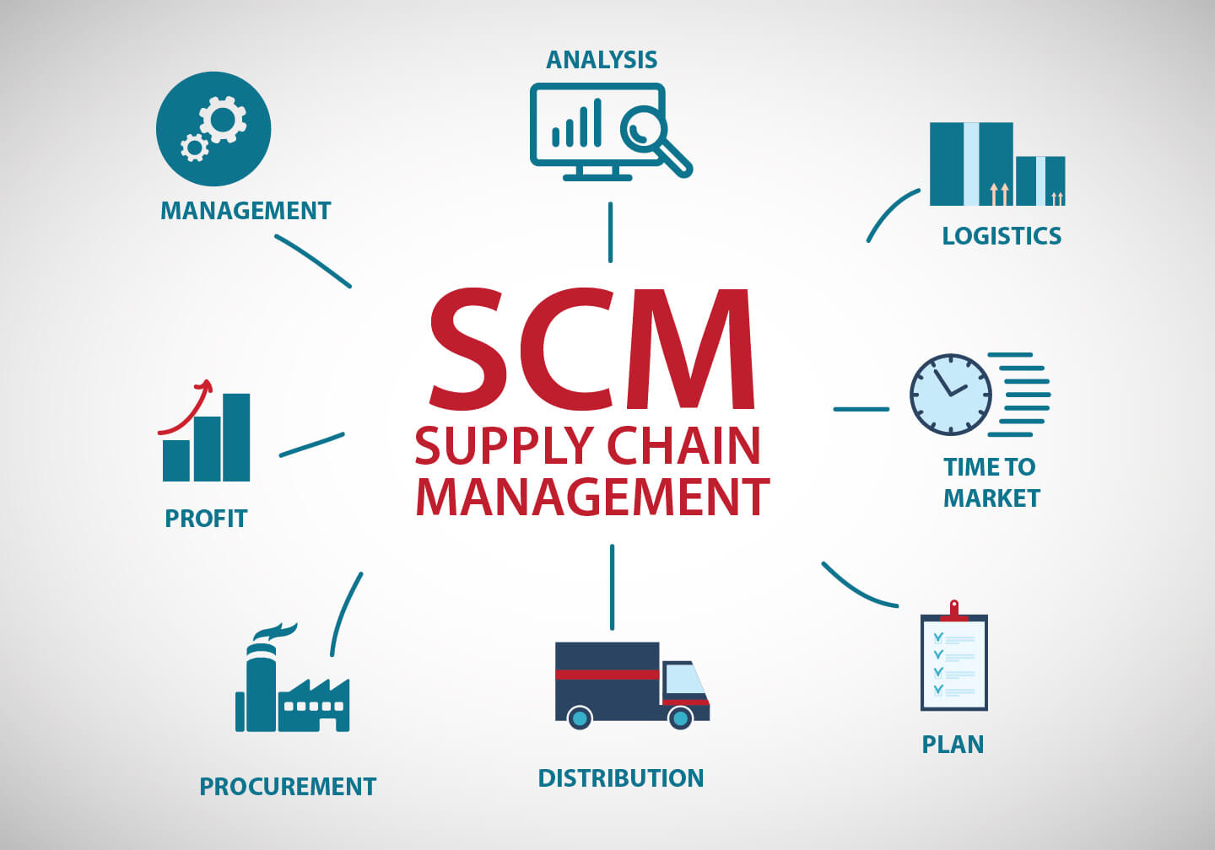



Supply Chain Management (SCM) System
Inventory Management
Partner Coordination
Track seat availability and show schedules in real-time.
Automate communication with theatres for scheduling and updates.
Demand Forecasting
Predict demand for specific movies or regions to optimize show timings.

Slide 65
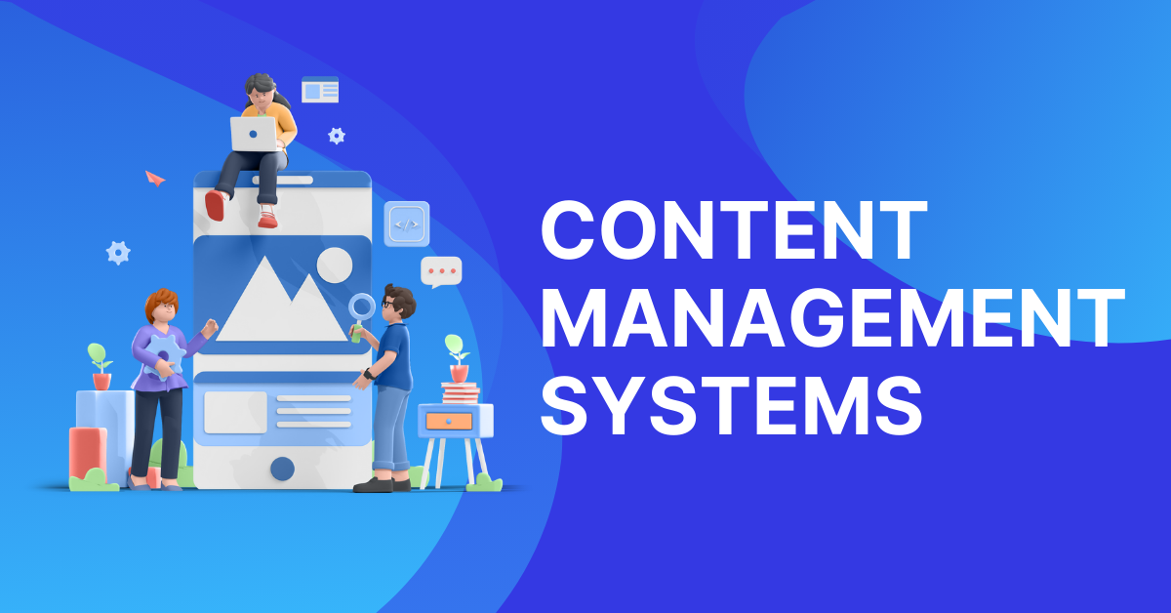

Content Management System (CMS)
Content Localization
Dynamic Content Delivery
Manage translations for movie metadata, descriptions, and promotional materials.
Serve region-specific content based on user location or language preferences.
Version Control
Track changes to content and ensure consistency across platforms.

Slide 66

Payment Management System
1
Payment Gateway Integration
Support multiple payment methods and gateways based on region.
2
Transaction Monitoring
Track successful and failed transactions in real-time.
3
Refund Management
Automate refund processing for canceled bookings.

Slide 67




Analytics and Business Intelligence (BI) System
1
Data Visualization
2
Predictive Analytics
3
Revenue Analysis

Slide 68
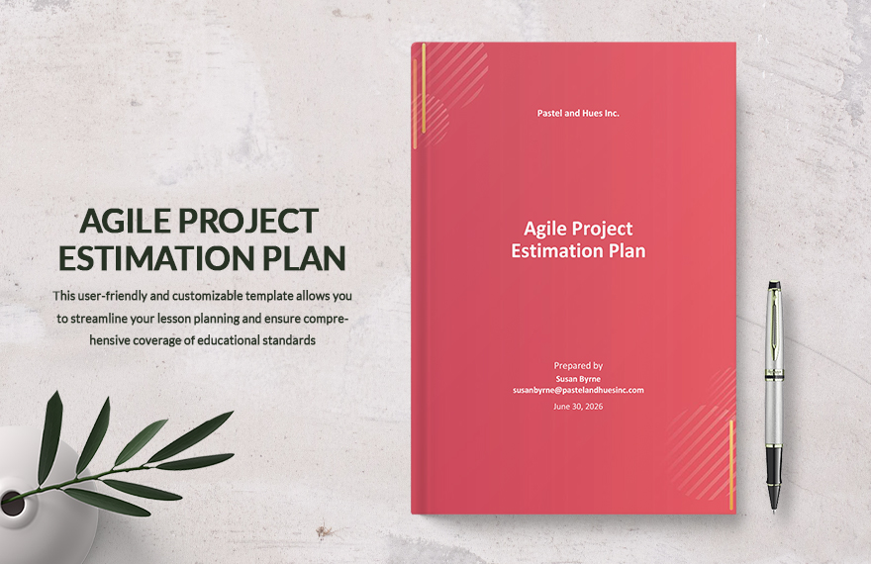
Agile Project Plan for Online Movie Ticket Booking Platform
This section outlines the Agile project plan for developing an online movie ticket booking platform, encompassing effort estimates, sprint breakdown, and a comprehensive duration plan.

Slide 69
Project Plan Overview
Methodology
Sprints
Agile, enabling iterative and incremental delivery, ensuring continuous feedback and adaptability.
2-week sprints delivering functional software in increments, allowing for rapid iteration and responsiveness.

Slide 70
High-Level Timeline
Phase 1
1
Project initiation and planning, setting the foundation for a successful project.
2
Phase 2
Requirements gathering and backlog creation, defining the scope and features of the platform.
Phase 3
3
System design, crafting the architectural blueprint for the platform.
4
Phase 4
Development, bringing the platform to life with core functionalities.
Phase 5
5
Testing & QA, ensuring the platform meets quality standards and delivers a seamless user experience.
6
Phase 6
Deployment and support, launching the platform and ongoing maintenance

Slide 71
Effort Estimates by Phase
Phase
Effort (Hours)
Key Roles
Sprint Allocation
Project Initiation & Planning
80
Project Manager, Architect
Sprint 1
Requirements Gathering
120
Business Analyst, Product Owner
Sprint 2
Incremental System Design
160
Architect, UI/UX Designer
Sprint 3-4
Incremental Development
1,200
Developers, DevOps Engineers
Sprint 5-10
Testing & QA
200
QA Engineers
Sprint 11-12
Deployment
80
DevOps Engineers, Support Team
Sprint 13
Post-Deployment Support
40/month
Support Team, Developers
Ongoing

Slide 72



Sprint Breakdown
1
Sprint 1
2
Sprint 2
3
Sprint 3
Project kickoff, roadmap creation, and initial backlog setup.
Requirements gathering, user story creation, and backlog prioritization.
High-level architecture design and wireframes for core features.
4
Sprint 4
5
Sprint 5
6
Sprint 6
Detailed system design, database schema, and API design.
User registration and authentication service development.
Movie metadata service development.
7
Sprint 7
8
Sprint 8
9
Sprint 9
Theatre management service development.
Booking service development.
Payment service development.
10
Sprint 10
11
Sprint 11
12
Sprint 12
Notification service development.
Functional and integration testing.
Bug fixes, performance testing, and final QA.
13
Sprint 13
Production deployment, monitoring setup, and go-live.

Slide 73


Cost Estimates
1,840
$50
$92,000
Total Effort
Average Hourly Rate
Total Cost
Hours
Per hour

Slide 74


Agile Milestones
1
Project Kickoff
Week 1
2
Requirements Finalized
Week 5
3
System Design Completed
Week 9
4
MVP Development Completed
Week 21
5
Testing Completed
Week 25
6
Platform Go-Live
Week 27

